Slide 1
Wandering tales
Team united

Slide 2
AGENDA
Problem statement
Project Overview
Solution and its value
End Users
Modelling
Wow Moment
Result

Slide 3
PROBLEM STATEMENT
The website is for helping people who have no idea about unknown places and unknown food because we people facing many problems as a new comer in new places so this website is specially useful for them.
Our website takes pride in showcasing lesser-known places that are off the beaten path.

Slide 4
PROJECT OVERVIEW
Our project is about Kolkata’s famous places and foods.
Our website has 5 pages the first page is main page or home page it is a page which is viewed by the user.
The second page is about to explore tourist places
The third page is about like unknown or famous places specially.
The fourth page is about food.
And the last and fifth page is about contact us etc.

Slide 5

YOUR SOLUTION AND ITS VALUE PROPOSITION
Our website is your ultimate guide to uncovering the hidden gems of any town or city. Whether you're a seasoned traveler or a curious newcomer, we've got you covered with hidden gems.
Our website takes pride in showcasing lesser-known places that are off the beaten path.

Slide 6
Who are the end user
The end users are specially tourist and our new visitors outsiders citizens etc.

Slide 7
MODELING
Wandering Tales of Kolkata
HOME
ABOUT US
PLACE
CUISINE
CONTACT
INTRODUCTION
HERITAGE PLACES
HERITAGE FOOD

Slide 8
Wow Moment
A user friendly website which can be used easily by our users.
Any person can use our website and visit according whatever they needs.
It is easy to use and understand
You can’t feel confused and unclear about our any given information.

Slide 9
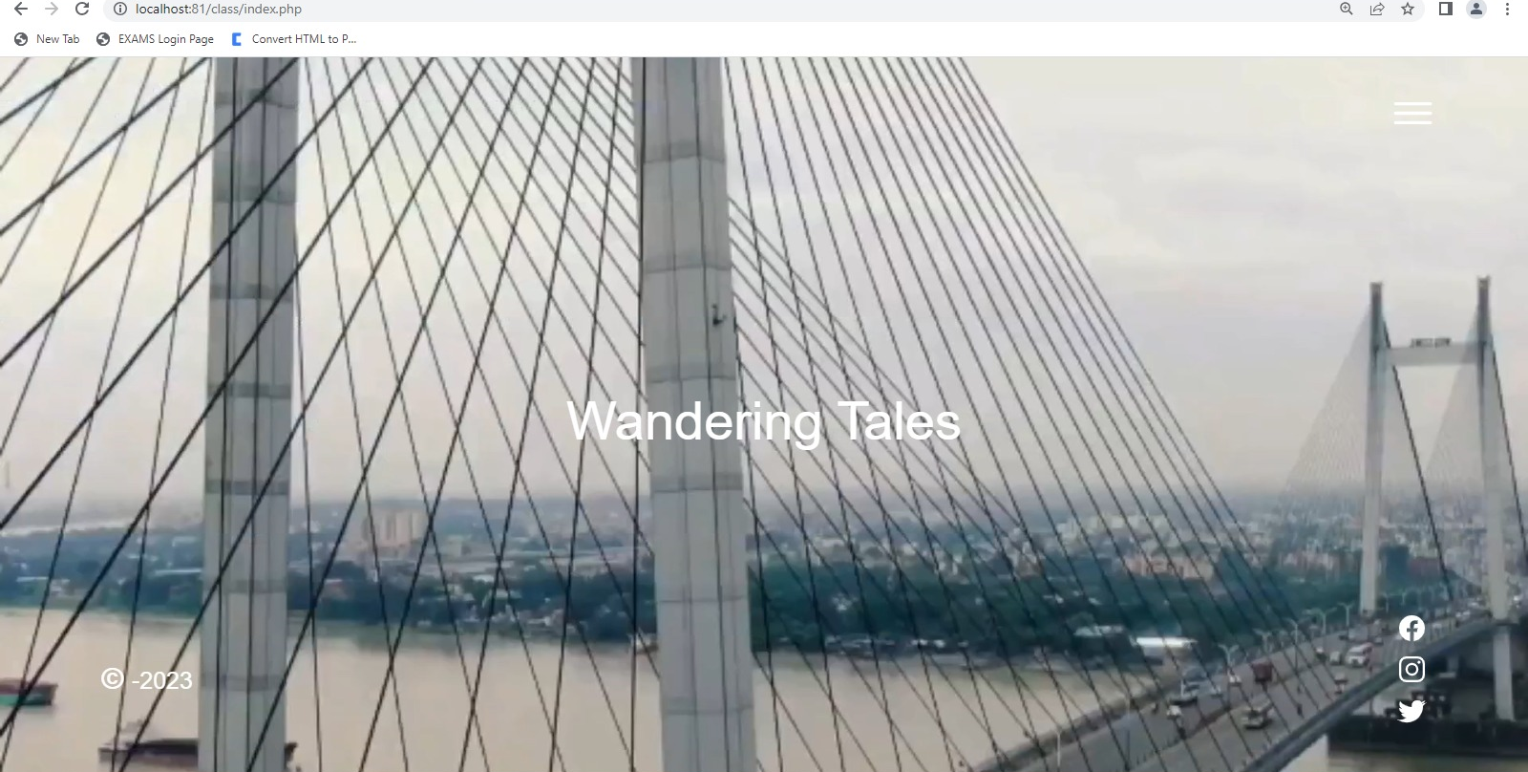
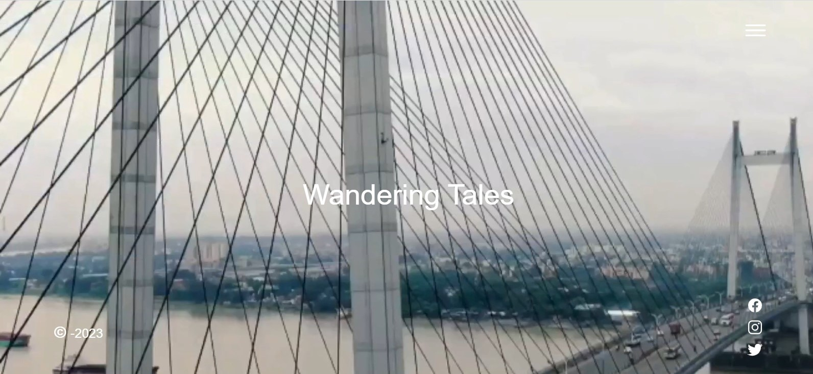
RESULTS
People can find heritage food and places through our website easily.

Slide 10
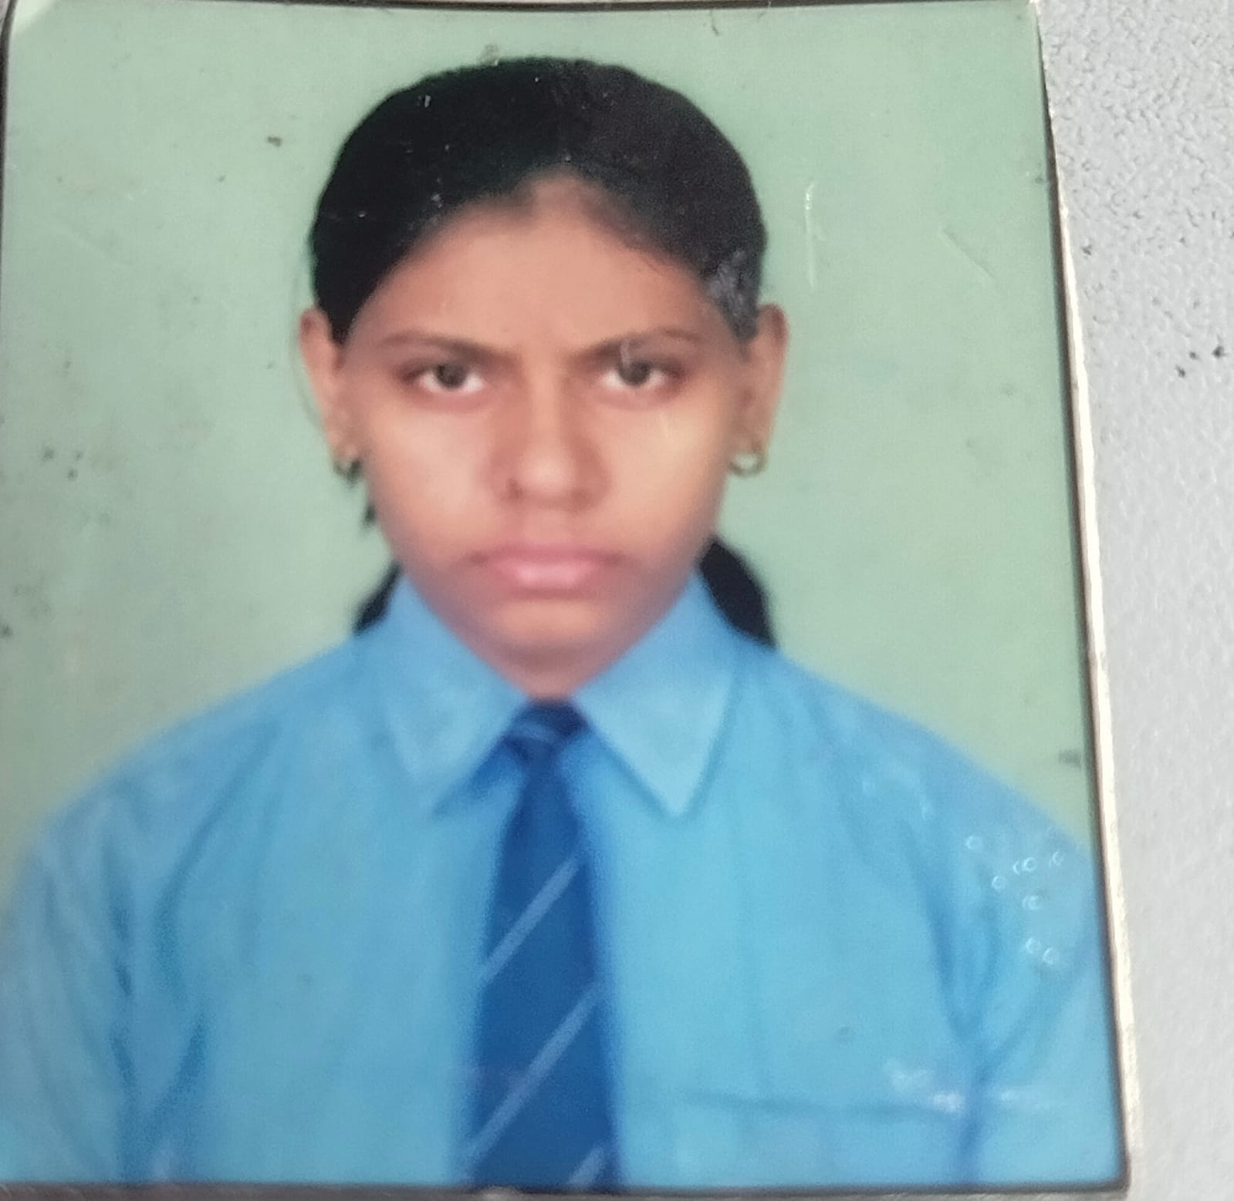
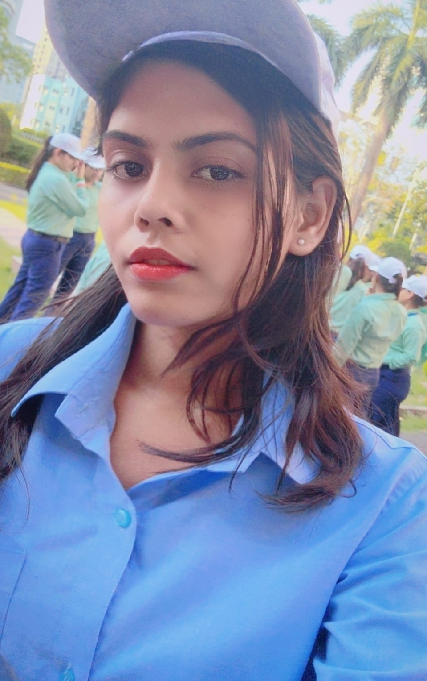
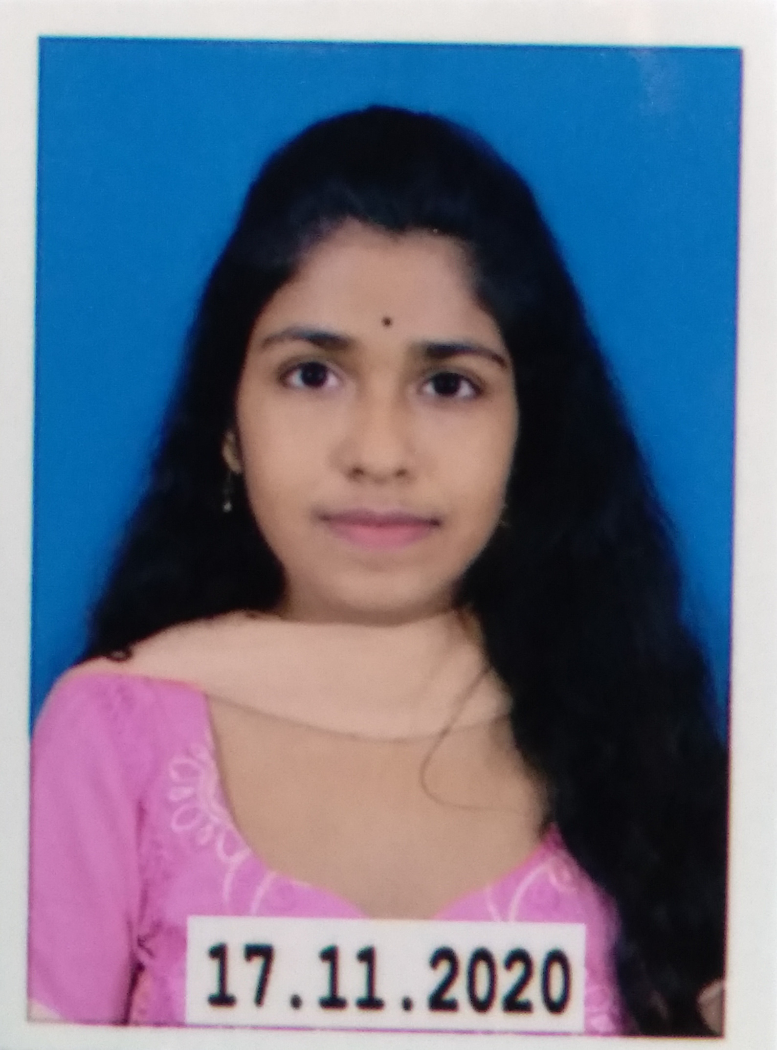
MEET OUR TEAM
Manjima Bhattacharyya
Aashika Raj
Srimana Maity

Slide 11

Thank you
This Photo by Unknown Author is licensed under CC BY-SA

